Slide 1
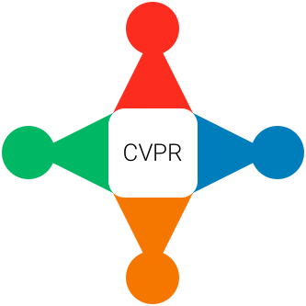
How to be a good citizen of the CVPR community
June 22nd, 2018
CVPR 2018

Slide 2
Why?
Non-technical factors are also important
New members of the community
Reference material
(Our students kept asking for it ☺)
Notes:
Wouldn't it be nice to have a tutorial at CVPR on how to be a good reviewer? Maybe also a good AC? Even a good PAMI TC member (e.g., what to consider when you vote for things). How to be inclusive? How to be a good collaborator? How to give good talks? Just overall -- a tutorial on how to be a good citizen of the CVPR community. The general culture of the community makes a huge difference in how the science we do gets disseminated and as a result, in how the work we do makes impact. What the community values significantly affects many decisions that affect people's careers in significant ways, which in turn, affects the kind of work we as a community continue to do over time. But these things never get "taught" and talked about. This seems problematic, especially as the community grows.

Slide 3
Panel of speakers

Slide 4
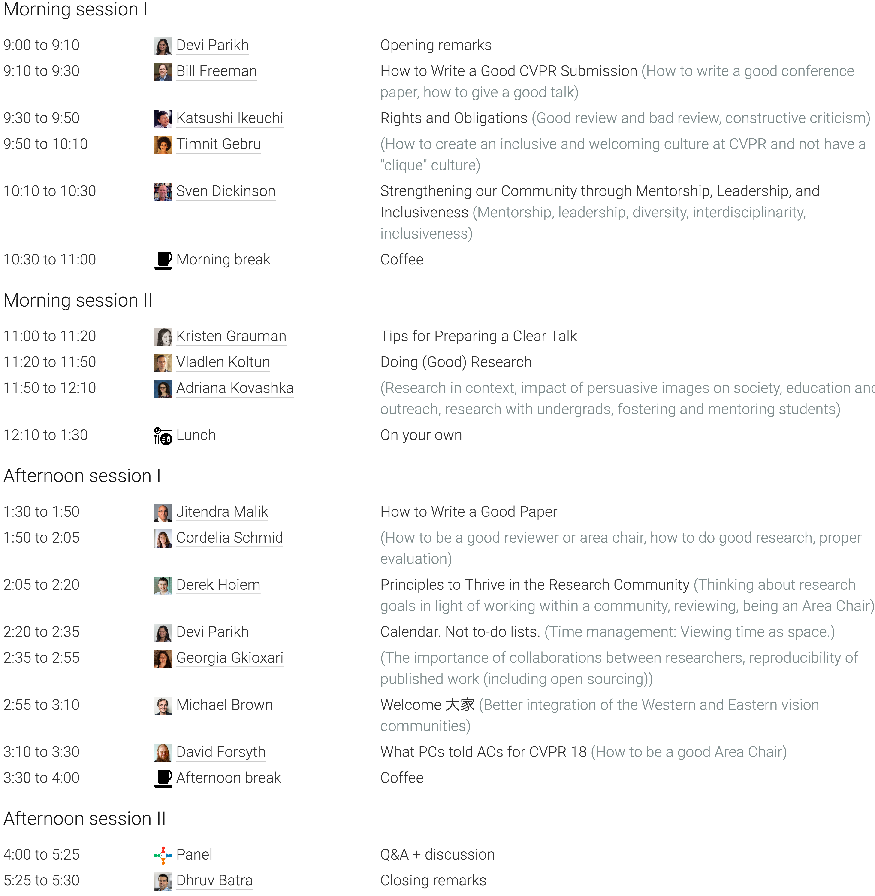
Notes:
We will hear about how to do good research, how to write good papers, how to give a good talk, how to be good reviewers, how to be good area chairs, proper evaluation, constructive criticism, how to be inclusive, how to better integrate the western and eastern vision communities, diversity, education and outreach, mentorship, leaderships, how to think about research in context, collaboration, reproducibility, open source, time management --> and then at the end of the day we’ll have a panel!

